Slide 1
Microservices and DevOps
Scalable Microservices
Redis
Henrik Bærbak Christensen

Slide 2
Motivation
RDB’s datamodel provide a rich modeling of data and queries
Tables, keys, foreign keys
Query language, sorting, filtering, ...
But lack a notion of objects (nested lists, nested objects, etc.)
MongoDB’s datamodel actually is even richer
JSON documents – can have nested documents and lists !
Query langage, sorting, filtering is well supported
Map Reduce

Slide 3
Motivation
Redis is a key-value store and perhaps closer to the ‘heart’ of NoSQL
In memory, extremely fast, simple API
And…
I have been using MongoDB since 2012 so about time to try something new…
Disclaimer
I am on thin ice here, learning as you do!
Feedback – publish good hints on forum ☺

Slide 4
What to do with just the core?
Key value stores require you to think in other ways
How do you create relations? Nested objects?
How do you query/search when you only have keys???
The answer seems to be
Create computed/foreign keys
Key is not ‘8375a66b’ but ‘Room(0,0,0)’ – computed from domain
{course: ‘msdo’, participants: ‘plist_64ab2’}; pointing to a list of part.
Create secondary indices
Special lookup data structures that index your core data
Any CRUD is then updates of two+ datastructures
Add both the core data + add meta data to secondary index

Slide 5
Redis
An Advanced key-value store

Slide 6
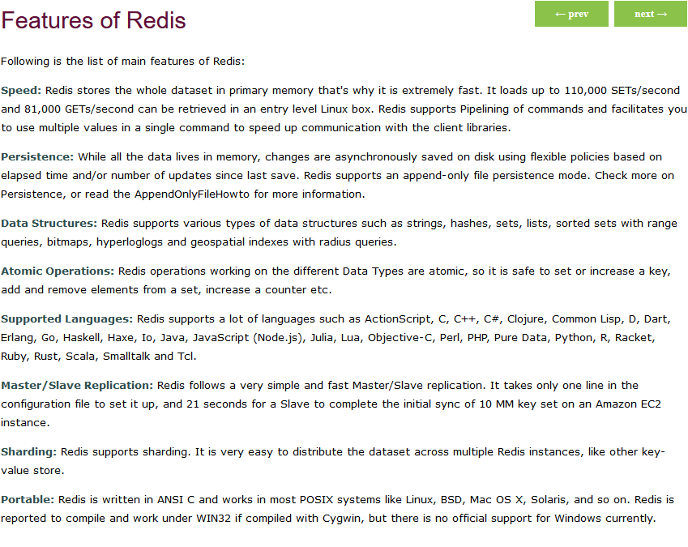
Features
https://www.javatpoint.com/features-of-redis

Slide 7
Fundamental Data Structures
So – besides just (key, value) you also get things like lists (arrays/ordered in insertion sequence) and sets (unordered, no duplicates) and others

Slide 8
Examples
The core HashMap thingy

Slide 9
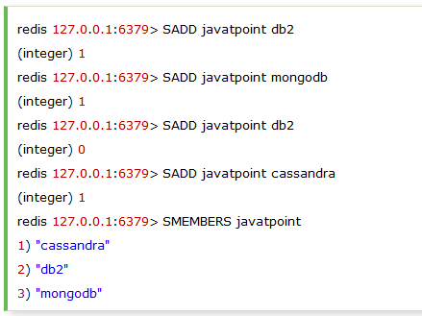
Examples
Sets

Slide 10
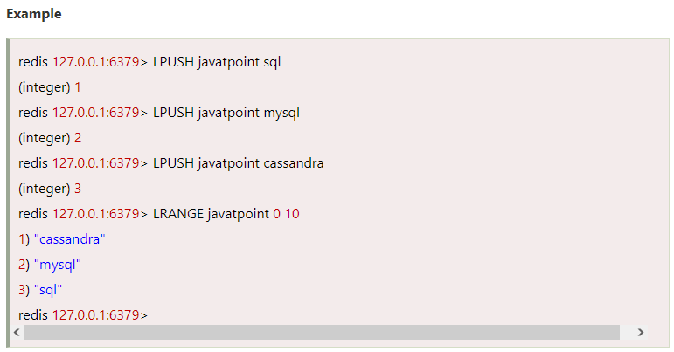
Examples
Lists can be stored/read from head or tail

Slide 11
Examples
Allows you to associate a score with each value in the set, and then retrieve only values within a given score range
key score value

Slide 12
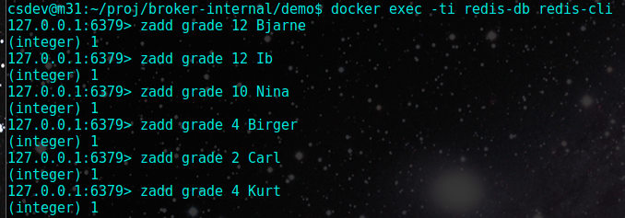
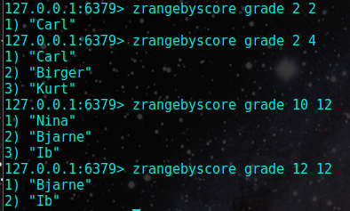
Examples
‘Sorted Set’ seem like a good candidate for search indices
‘Query’ = get all values whose score is in a given range.

Slide 13
Examples
Hashes = the value is a HashMap itself
I.e something like
(‘msdo’, { teacher: hbc, students: 17, website: “baerbak.cs….”})

Slide 14
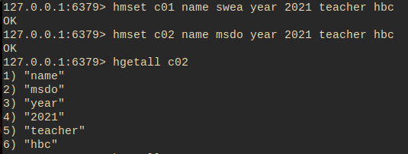
Examples
Structured objects/records
A set of (key,value) under one single key

Slide 15
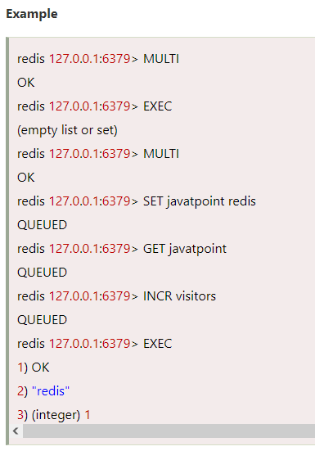
Transactions
Bob bob
Insert may mean two things
A) update main structure
B) update secondary index
Design for Failure
What happens if Redis dies between A) and B)?
Atomicity is possible
Transactions: multi + exec

Slide 16
Playing Around
Docker

Slide 17
Playing Around
Test driving Redis is easy
Start a Redis non-persisting DB on standard port 6379
Start a CLI
docker exec –ti redis-db redis-cli
And play around in the shell
Find the ‘latest’ redis to use on Docker Hub

Slide 18
Java Driver
Jedis

Slide 19
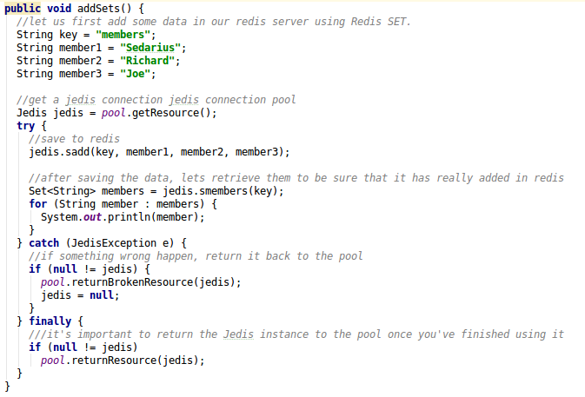
Examples
Redis commands are reflected ‘verbatim’ in Jedis
https://javapointers.com/tutorial/use-redis-java-using-jedis/

Slide 20
Jedis Pool
pool.getResource()
Returns a jedis connection; i.e. a new socket connection
Do not use just a single connection for all transactions
Instead retrieve a new one for each ‘operation’ you need
Ala ‘cavestorage.addRoom()…’
Why not?
Use the modern Java style ‘try-with-resources’
try (Jedis jedis = pool.getResource()) { do stuff; }
… to avoid writing a zillion ‘finally { jedis.close(); }
Notes:
If the connection fails temporarily you introduce permanent error in your connector code. Getting a new connection each time will mitigate such failures. Design for Failure.

Slide 21
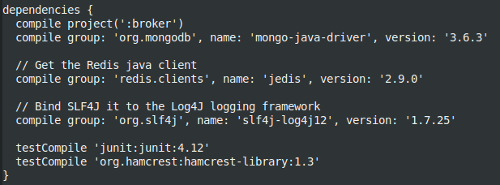
Jedis – Java Driver
Java Driver
Find latest driver at mvnrepository.com
https://javapointers.com/tutorial/use-redis-java-using-jedis/

Slide 22
Scaling to MSDO

Slide 23
Architecture in MS Context
Promises ‘availability’ and ‘scalability’
Looking forward to try it ☺

